Slide 1
Welcome to SMD Build Night!
Notes:
SMD project by Tom Keddie
Sample star

Slide 2
Housekeeping
Hi/Intro/thanks
Safety
Wear eye protection as solder splatters can cause permanent damage.
Cover any open cuts with band-aids and wash hands with soap afterwards because…lead.
Tie long hair back and be careful of hot irons/ovens/etc.
Clean up is from 9:30 - 10
Notes:
- SMD project by Tom

Slide 3
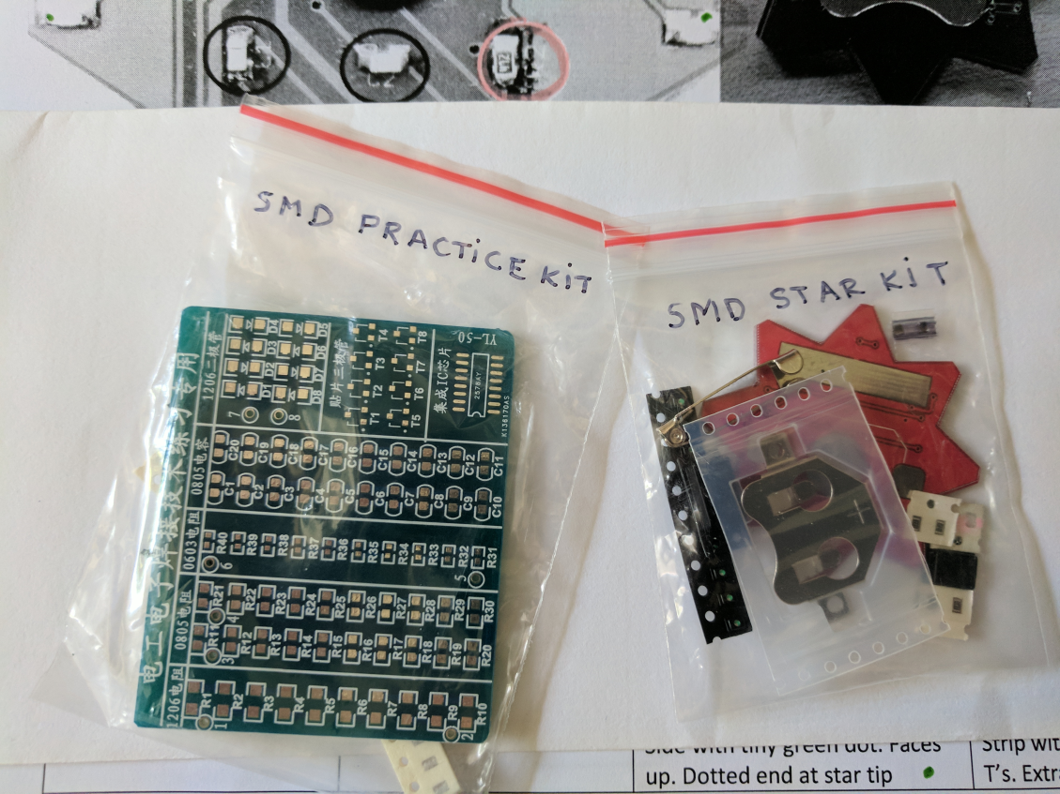
What We’re Making!
1. Practice Kit (hand-solder a few parts not the whole thing ~ 15 mins)
2. Star Kit (build with reflow oven, rest of evening)

Slide 4
Hand Soldering SMDs
Hand Soldering with Tom
https://www.youtube.com/watch?v=P_6XJR3D27Y
Hand Soldering with more flux
https://www.youtube.com/watch?v=3NN7UGWYmBY
Desoldering: https://www.youtube.com/watch?v=8JM4oCpWnjU&t=6s

Slide 5
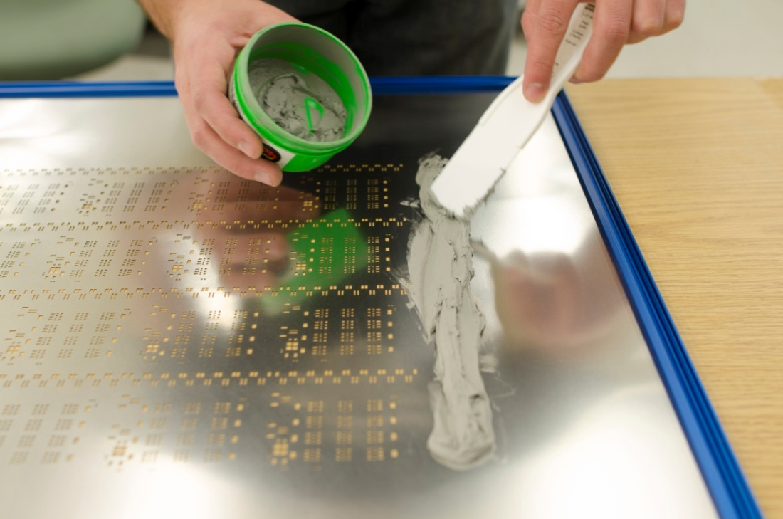
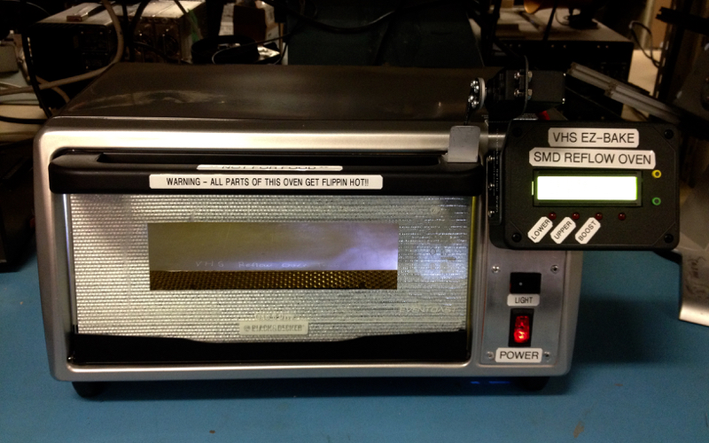
Stenciling and Baking SMDs
What happens inside the reflow oven:
https://www.youtube.com/watch?v=c2flmUWlO14

Slide 6
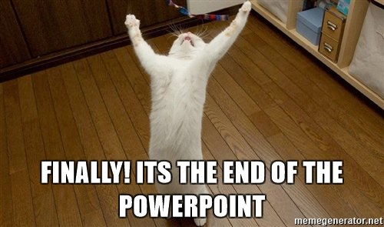
Stencil &Oven Demo/Make stuff
Notes:
Time for stenciling and oven demos.

